Slide 1
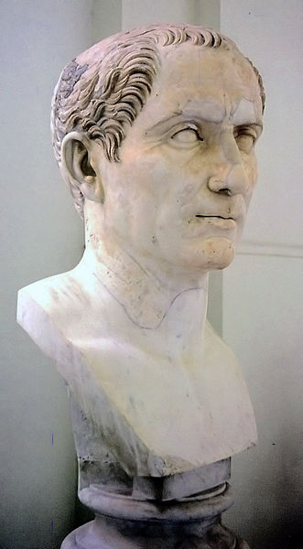
SOURCE: Julius Caesar (100BC- 44BC), Roman general & statesman
“Veni, vidi, vici” Latin for “I came, I saw, I conquered.”
What does this tell us about the Roman Empire?
What does conquer mean?
When Rome conquered other area, what does this tell us about ideas that started in Rome?
“Veni, vidi, visa” “I came, I saw, I shopped” Mrs. Julius Caesar

